Slide 1
Gestion efficace des ressources mémoire et de calcul pour l’exécution de système multi-agents sur architectures parallèles avec OpenCL
Anne Jeannin-Girardon, Vincent Rodin
Lab-STICC, UMR 6285, CNRS,
Dépt Informatique, Université de Brest
Compas’2016, vincent.rodin@univ-brest.fr

Slide 2
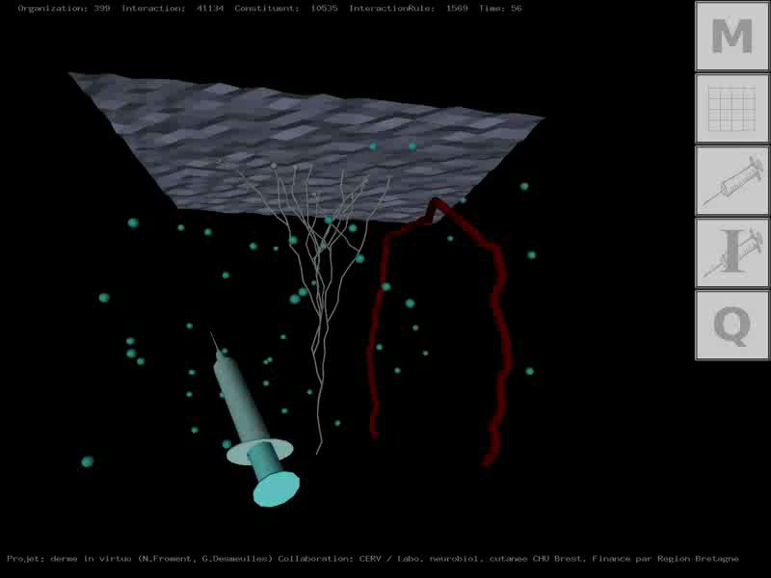
Virtual Reality ➔ Virtual Biology
Lab-STICC, CID, IHSEV
Multi-Agent System approach
Interaction between virtual cells and/or molecules

Slide 3
Context (1/3)

Slide 4
Context (2/3)
Our approach is hybrid
population level
(Molecular Virtual Chemistry)
individual level
(Virtual Cells)

Slide 5
Context (3/3)
From a computational point of view,
the work presented today is an improvement of
Anne Jeannin-Girardon Ph.D thesis, 2014
Anne Jeannin-Girardon et al, IEEE/ACM Transaction on Computational Biology and Bioinformatics, 2015

Slide 6
Outline
Introduction
➔ Morphogenesis & Dynamicity
Virtual Biological Model
➔ Virtual Cell, Molecular Virtual Chemistry, Virtual Growth
Parallel implementation
➔ OpenCL, model coupled with a MAS
How to get a new Id for a new Virtual Cell?
Results

Slide 7
Introduction (1/1)
Tissue morphogenesis:
Is a multi-scale phenomenon
Can be addressed through
continuous & discrete models
Involves many of interacting
entities (cells, molecules, etc.)
Implies birth and death of cells
➔ dynamicity
Tissular level
processes
Macroscopic
scale
Cell/Cell &
cell/ECM
interactions
Mesoscopic
scale
Sub-cellular/
molecular processes
Microscopic
scale

Slide 8
Virtual Biological Model (1/3)
Virtual Cell
Structure: mass/spring system
n+1 nodes
membrane, cytoskeleton, cortex
cell deformation
Mitose
orientated mitosis
given an axis
Cell adhesion/repulsion
differential interaction

Slide 9
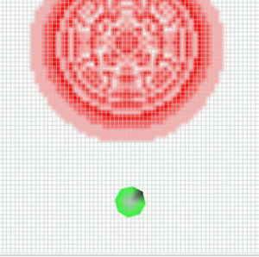
Virtual Biological Model (2/3)
Molecular Virtual Chemistry
Molecular level modelled
with
diffusion/reaction equations
δ_{i}(x,t)
δt
D_{i} Δ_{i}(x,t) – R_{i}(x,t)
=
Set of molecules. Ex: {A, B,C}
Set of reactions. Ex: {2A + B ➔ C}
Set of 2D discrete layers.
One grid layer per molecule type
Equations solved in 2 steps:
1) diffusion
2) reaction

Slide 10
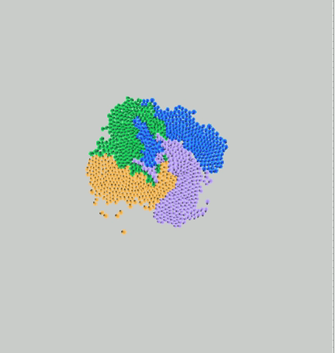
Virtual Biological Model (3/3)
Virtual Growth
TA
B
TB
produces
A
C
consumes
TD
D
TC
Dynamicity

Slide 11
Hey Vincent,
do you know that you are not in
a bioinformatics conference today?

Slide 12
Parallel implementation (1/2)
Parallel hardware and device are everywhere
Parallel programing gets easier
Numerous parallel frameworks are available
Our model seems well adapted to parallel implementation
We choose to use the OpenCL framework to implement it
➔ we can use CPUs, GPUs, FPGAs, etc.

Slide 13
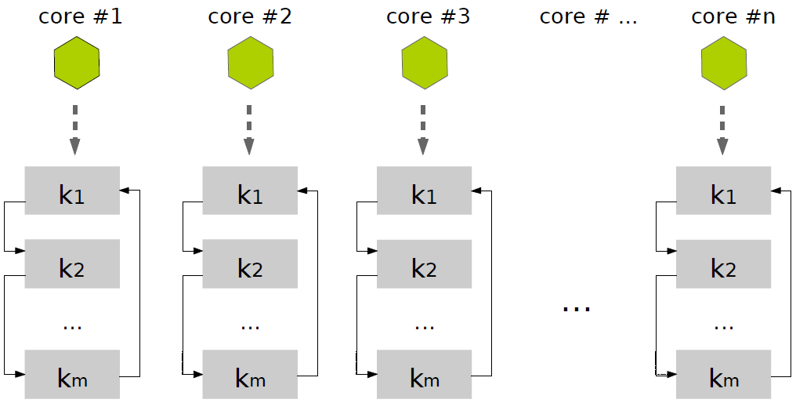
Parallel implementation (2/2)
Fine grained implementation: a cell = an OpenCL core
➔ model coupled with a Multi-Agent System
Kernel k1: computes forces
Kernel k2: integrates forces
(Euler method)
Data stored into structures of arrays: nodes, etc.
➔ adapted data structure for OpenCL: a cell = an id
Question: How to find a new Id for a new Virtual Cell?

Slide 14
How to get a new Id ? (1/3)
N (± 10⁶) Virtual Cells : structures of arrays
0 1 2 N-1
Active or
Inactive
Node 0
Node 1
Node 5
Node C
Etc.
At the beginning of the simulation… easy!

Slide 15
How to get a new Id ? (1/3)
N (± 10⁶) Virtual Cells : structures of arrays
0 1 2 N-1
Active or
Inactive
Node 0
Node 1
Node 5
Node C
Etc.
After births and deaths….?

Slide 16
How to get a new Id ? (2/3)
Some previous works (1): [Lysenko & D’Souza, 2008]
0 1 2 N-1
Active or
Inactive
Attributes
A stochastic method:
A random choise happens…
…until an inactive element is obtained!
Main drawback:
What appends if the memory is nearly full?

Slide 17
How to get a new Id ? (2/3)
Some previous works (2): [Jeannin-Girardon, Ph.D, 2014]
[Jeannin-Girardon et al, TCBB, 2015]
0 1 2 N-1
Active or
Inactive
Attributes
A hybrid method:
Dynamic switch : Stochastic Method & Parallel Sort

Slide 18
How to get a new Id ? (2/3)
Some previous works (2): [Jeannin-Girardon, Ph.D, 2014]
[Jeannin-Girardon et al, TCBB, 2015]
0 1 2 N-1
0 1 2 N-1
Active or
Inactive
Attributes
A hybrid method:
Dynamic switch : Stochastic Method & Parallel Sort
Main drawbacks:
- How to choose the thresholds to switch?
- Parallel sort… data transfers

Slide 19
How to get a new Id ? (3/3)
Our proposition (1): [Jeannin-Girardon et al, Compas, 2016]
0 1 2 N-1
Active or
Inactive
Attributes
Available Indexes are stored in two buffers & atomic_inc
PtrAllocation
0 1 2 N-1
Allocation
0 1 2 3 … … … … … … … … N-1
Deallocation
-1 -1 -1 -1 -1 -1 -1 -1 -1 -1 -1 -1 -1
PtrDeallocation

Slide 20
How to get a new Id ? (3/3)
Our proposition (1): [Jeannin-Girardon et al, Compas, 2016]
0 1 2 N-1
Active or
Inactive
Attributes
Available Indexes are stored in two buffers & atomic_inc
PtrAllocation
0 1 2 N-1
Allocation
-1 1 2 3 … … … … … … … … N-1
Deallocation
-1 -1 -1 -1 -1 -1 -1 -1 -1 -1 -1 -1 -1
PtrDeallocation

Slide 21
How to get a new Id ? (3/3)
Our proposition (1): [Jeannin-Girardon et al, Compas, 2016]
0 1 2 N-1
Active or
Inactive
Attributes
Available Indexes are stored in two buffers & atomic_inc
PtrAllocation
0 1 2 N-1
Allocation
-1 -1 2 3 … … … … … … … … N-1
Deallocation
-1 -1 -1 -1 -1 -1 -1 -1 -1 -1 -1 -1 -1
PtrDeallocation

Slide 22
How to get a new Id ? (3/3)
Our proposition (1): [Jeannin-Girardon et al, Compas, 2016]
0 1 2 N-1
Active or
Inactive
Attributes
Available Indexes are stored in two buffers & atomic_inc
PtrAllocation
0 1 2 N-1
Allocation
-1 -1 -1 3 … … … … … … … … N-1
Deallocation
-1 -1 -1 -1 -1 -1 -1 -1 -1 -1 -1 -1 -1
PtrDeallocation

Slide 23
How to get a new Id ? (3/3)
Our proposition (1): [Jeannin-Girardon et al, Compas, 2016]
0 1 2 N-1
Active or
Inactive
Attributes
Available Indexes are stored in two buffers & atomic_inc
PtrAllocation
0 1 2 N-1
Allocation
-1 -1 -1 3 … … … … … … … … N-1
Deallocation
1 -1 -1 -1 -1 -1 -1 -1 -1 -1 -1 -1 -1
PtrDeallocation

Slide 24
How to get a new Id ? (3/3)
Our proposition (1): [Jeannin-Girardon et al, Compas, 2016]
0 1 2 N-1
Active or
Inactive
Attributes
Available Indexes are stored in two buffers & atomic_inc
PtrAllocation
0 1 2 N-1
Allocation
-1 -1 -1 3 … … … … … … … … N-1
Deallocation
1 -1 -1 -1 -1 -1 -1 -1 -1 -1 -1 -1 -1
PtrDeallocation

Slide 25
How to get a new Id ? (3/3)
Our proposition (1): [Jeannin-Girardon et al, Compas, 2016]
0 1 2 N-1
Active or
Inactive
Attributes
Available Indexes are stored in two buffers & atomic_inc
PtrAllocation
0 1 2 N-1
Allocation
-1 -1 -1 3 … … … … … … … … N-1
Deallocation
1 2 -1 -1 -1 -1 -1 -1 -1 -1 -1 -1 -1
PtrDeallocation

Slide 26
How to get a new Id ? (3/3)
Our proposition (1): [Jeannin-Girardon et al, Compas, 2016]
0 1 2 N-1
Active or
Inactive
Attributes
Available Indexes are stored in two buffers & atomic_inc
PtrAllocation
0 1 2 N-1
Allocation
-1 -1 -1 3 … … … … … … … … N-1
Deallocation
1 2 -1 -1 -1 -1 -1 -1 -1 -1 -1 -1 -1
PtrDeallocation

Slide 27
How to get a new Id ? (3/3)
Our proposition (1): [Jeannin-Girardon et al, Compas, 2016]
0 1 2 N-1
Active or
Inactive
Attributes
Available Indexes are stored in two buffers & atomic_inc
PtrAllocation
0 1 2 N-1
Allocation
SWAP
-1 -1 -1 -1 -1 -1 -1 -1 -1 -1 -1 -1 -1
Deallocation
1 2 -1 -1 -1 -1 -1 -1 -1 -1 -1 -1 -1
PtrDeallocation

Slide 28
How to get a new Id ? (3/3)
Our proposition (1): [Jeannin-Girardon et al, Compas, 2016]
0 1 2 N-1
Active or
Inactive
Attributes
Available Indexes are stored in two buffers & atomic_inc
PtrAllocation
0 1 2 N-1
Allocation
1 2 -1 -1 -1 -1 -1 -1 -1 -1 -1 -1 -1
Deallocation
-1 -1 -1 -1 -1 -1 -1 -1 -1 -1 -1 -1 -1
PtrDeallocation

Slide 29
How to get a new Id ? (3/3)
Our proposition (2): [Jeannin-Girardon et al, Compas, 2016]
res = atomic_inc(var): OpenCL atomic operation
➔ tmp=var; var++; return tmp
Allocation:
Ptr = atomic_inc(PtrAllocation)
If Ptr < N and Allocation[Ptr] != -1
Then Id = Allocation[Ptr]
Allocation[Ptr] = -1
Return Id
Endif
Deallocation:
Ptr = atomic_inc(PtrDeallocation)
Desallocation[Ptr] = Id
PtrAllocation
0 1 2 N-1
Allocation
1 2 -1 -1 -1 -1 -1 -1 -1 -1 -1 -1 -1
Deallocation
-1 -1 -1 -1 -1 -1 -1 -1 -1 -1 -1 -1 -1
PtrDeallocation

Slide 30
How to get a new Id ? (3/3)
Our proposition (3): [Jeannin-Girardon et al, Compas, 2016]
Swap conditions:
PtrAllocation
0 1 2 N-1
Allocation
SWAP
-1 -1 -1 -1 -1 -1 -1 -1 -1 -1 -1 -1 -1
Deallocation
1 2 -1 -1 -1 -1 -1 -1 -1 -1 -1 -1 -1
PtrAllocation
0 1 2 N-1
Allocation
-1 -1 -1 -1 -1 -1 -1 -1 -1 -1 -1 -1 -1
SWAP
Deallocation
3 5 4 -1 -1 -1 -1 -1 -1 -1 -1 -1 -1

Slide 31
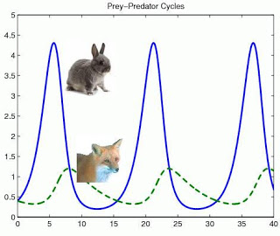
Results: Prey-Predator model (1/2)
Prey-Predator model
High dynamicity…

Slide 32
Results: Prey-Predator model (2/2)
Hybrid method
Double buffer method

Slide 33
Questions ?

