Slide 1
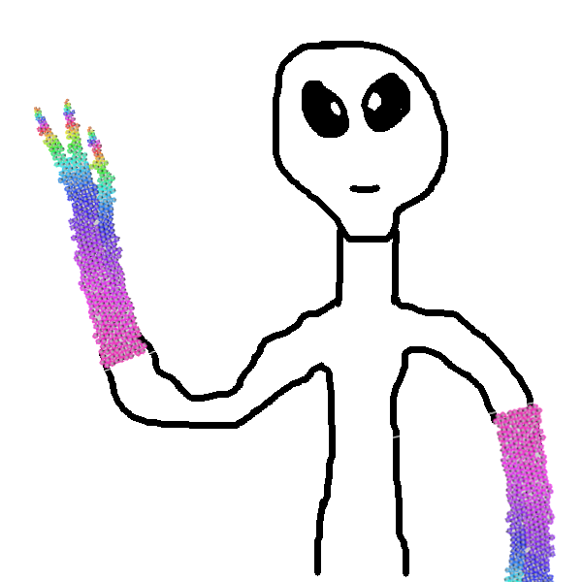
A multiagent approach for virtual tissue morphogenesis
Vincent Rodin,
Anne Jeannin-Girardon, Abdoulaye Sarr,
Jérémy Rivière, Alexandra Fronville, Pascal Ballet
Lab-STICC, UMR 6285, CNRS,
Computer Science Dept,
University of Brest, France

Slide 2
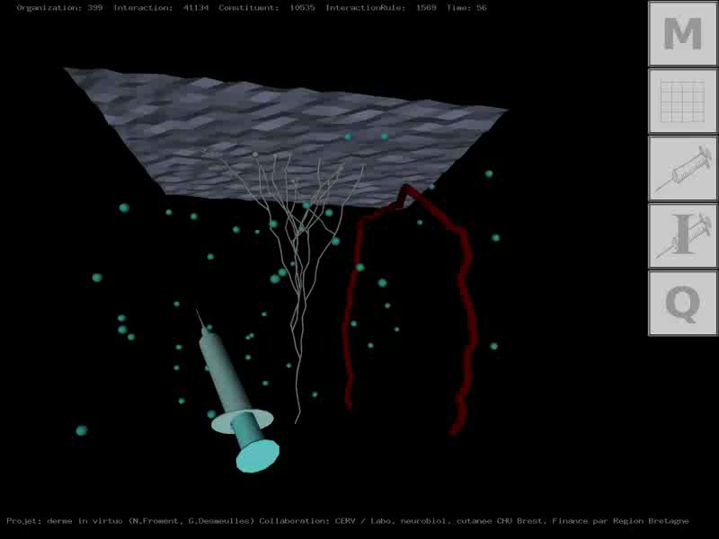
Virtual Reality ➔ Virtual Biology
Lab-STICC
Multi-Agent System approach
Interaction between virtual cells and/or molecules

Slide 3
Context (1/3)

Slide 4
Context (2/3)

Slide 5
Context (3/3)

Slide 6
Outline
Introduction
Virtual cell model
➔ Structure, cycle, abilities, interactions & constraints
Virtual chemistry model
Parallel implementation
➔ OpenCL, model coupled with a MAS, 10⁶ cells
Starfish growth… a simplified model
Towards morphogenesis modeling ?
Morphogenesis modeling : our approach based on viability
Morphogenesis modeling : our model, a case study
Future works

Slide 7
Introduction (1/4)
Tissue morphogenesis:
Tissular level
processes
Macroscopic
scale
Is a multi-scale phenomenon
Can be addressed through
continuous/discrete models
Involves many of interacting
entities (cells, molecules, etc.)
Cell/Cell &
cell/ECM
interactions
Mesoscopic
scale
Sub-cellular/
molecular processes
Microscopic
scale

Slide 8
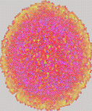
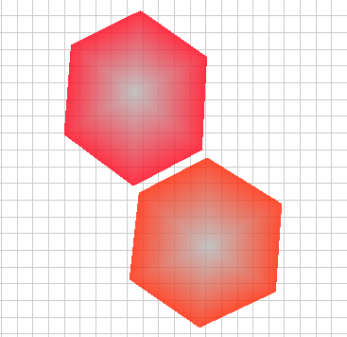
Introduction (2/4)
Tissue morphogenesis: continuous VS discrete approaches
Continuous approaches
Discrete approaches
Consider population
instead of individuals
Adapted for large
scale simulation
Take into account
the whole system
Local interactions definition
global emerging behaviors
Require a large amount
of computation time
Can focuse on a small part
of the system

Slide 9
Introduction (3/4)
Tissue morphogenesis: our approach is hybrid
Continuous approaches
Discrete approaches
But, we choose to favor discrete approaches:
Discrete modeling of entities allows variability
in cell population… and allows cell differentiation
Individual Based Models (IBM) are often suited
for a parallel implementation
Continous approach can be used when needed
(chemical gradient, etc.)

Slide 10
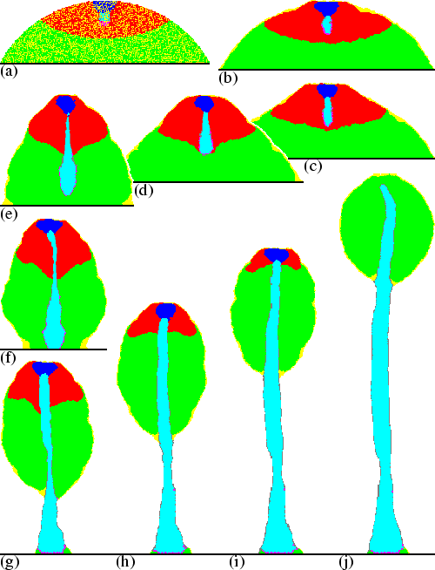
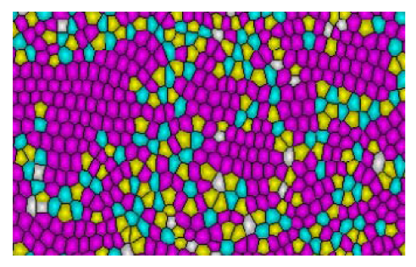
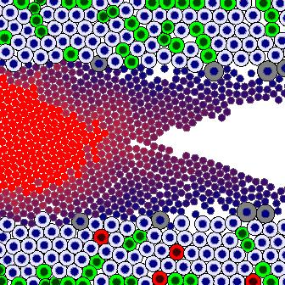
Introduction (4/4)
Discrete cellular models
Some models focus on the internal dynamics of cells
➔ too complex to simulate tissue
Some models focus on cell behaviors
➔ mitosis, differentiation, etc.
Marée et al, 2001
Li et al, 2012
Macklin et al, 2012
Kang et al, 2014
Some models are parallelized using various frameworks
➔ OpenMP, MPI, Posix thread, CUDA, openCL, etc.
➔ Laptops, standard PC, Super Computer, Grid, etc.

Slide 11
Virtual cell model (1/6)
Virtual cell structure: mass/spring system
n+1 nodes
➔ membrane, cytoskeleton, cortex
Cell deformation
Virtual cell cycle: very (too) simple one
finite-state machine
➔ no checkpoint
Cell control
Virtual cell mechanotransduction
Cell physical constraint evaluation

Slide 12
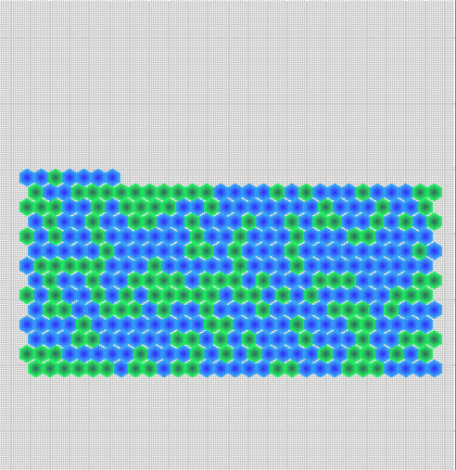
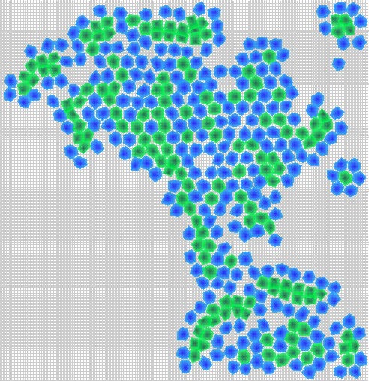
Virtual cell model (2/6)
Virtual cells agents
behaviors and abilities
Interacting cells
deformation
motility
migration along a molecular gradient
molecules consumption/production
differentiation
mitosis
apoptosis/necrosis
cell interactions
mechanotransduction
Example: cell sorting

Slide 13
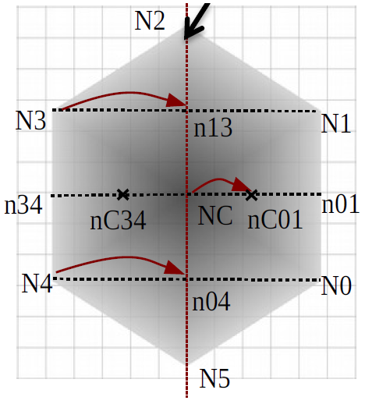
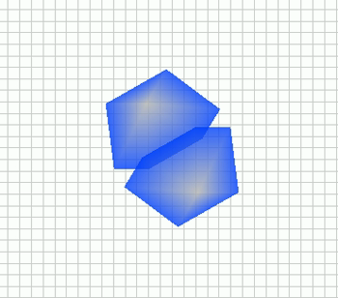
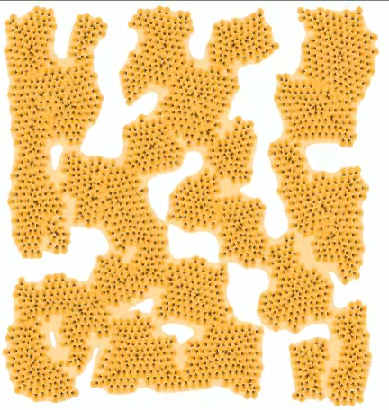
Virtual cell model (3/6)
Mitose and cell interactions
Division Axis
Mitose
orientated mitosis
given an axis
division.mp4
Cell adhesion/repulsion
differential interaction:
simplified mechanism
(selected nodes bind with the
center of the neighbouring cell)
aggregation.mp4

Slide 14
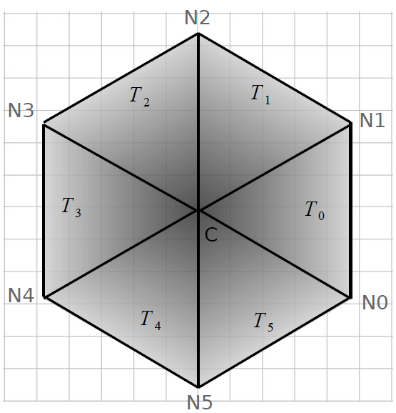
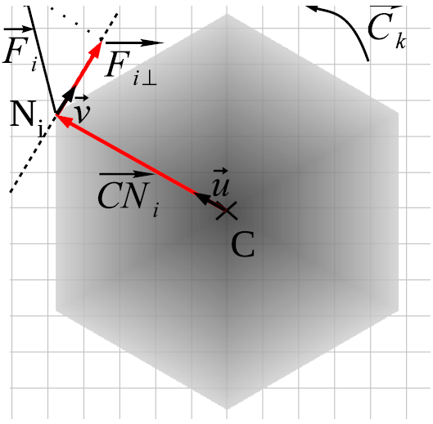
Virtual cell model (4/6)
Mechanical constraints evaluation
➔ Mechanotransduction ⬅
Surface compression/stretching
sum of the area triangles
composing the cell
Shearing constraints
computation of the couple cells ungerdo

Slide 15
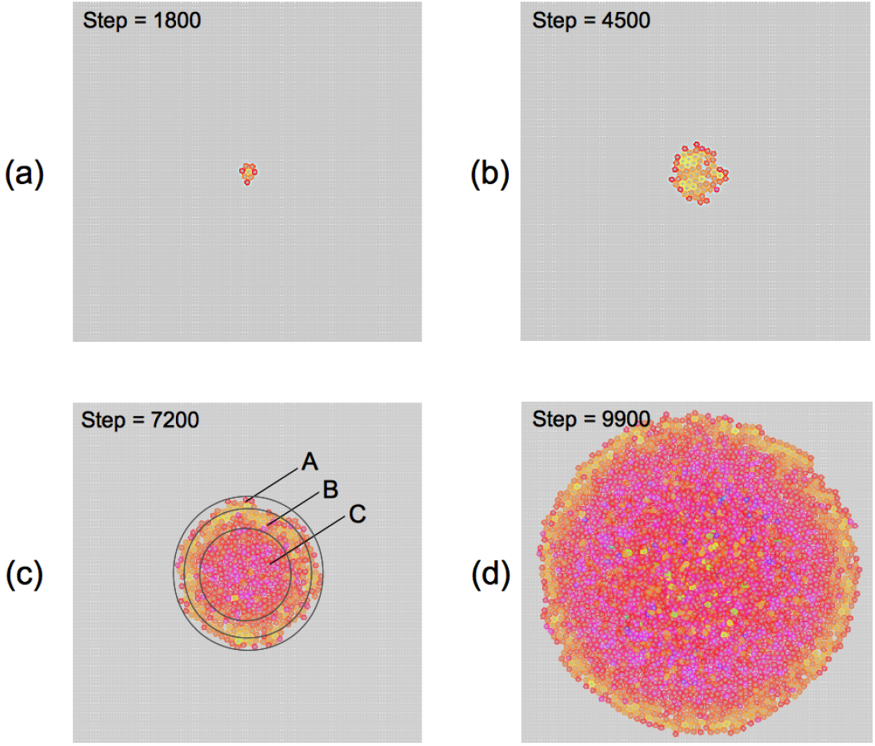
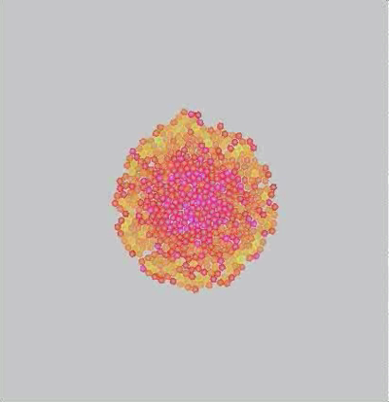
Virtual cell model (5/6)
Hypothesis:
The compression/stretching constraints cells undergo can induce a differentiation
We represent a cell differentiation by a change in the cell’s color
compression.mp4
compression.mp4

Slide 16
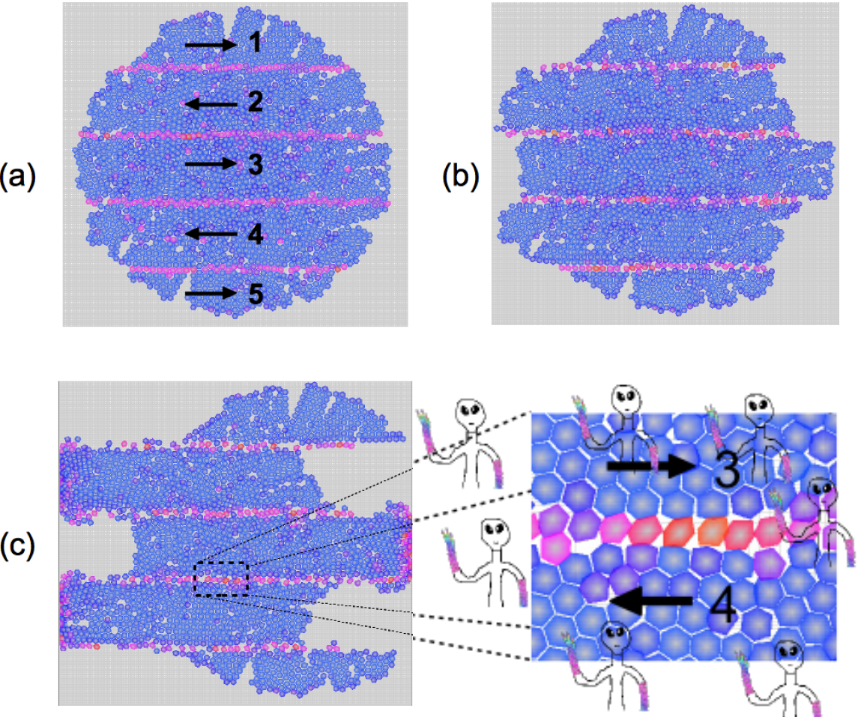
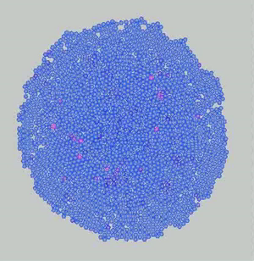
Virtual cell model (6/6)
Hypothesis:
The shearing constraints
cells undergo can induce a differentiation
We represent a cell differentiation by a change in the cell’s color
shear.mp4

Slide 17
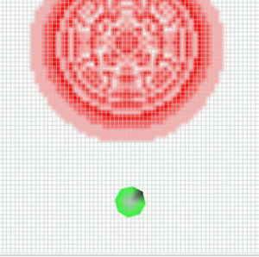
Virtual chemistry model (1/2)
Discrete molecular level
modelized with
diffusion/reaction equations
δ_{i}(x,t)
δt
D_{i} Δ_{i}(x,t) – R_{i}(x,t)
=
Set of molecules. Ex: {A, B,C}
Set of reactions. Ex: {2A + B ➔ C}
Set of 2D discrete layers.
One grid layer per molecule type
Equations solved in 2 steps:
1) diffusion
2) reaction
migration_chemical_gradient.mp4

Slide 18
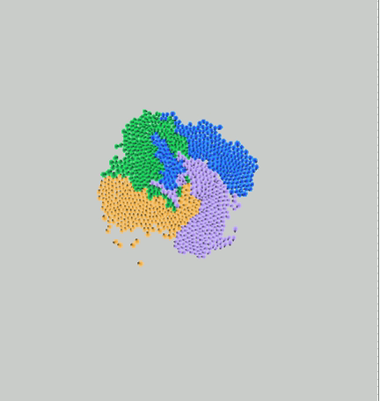
Virtual chemistry model (2/2)
TA
B
TB
produces
A
C
consumes
TD
D
TC
proliferation.mp4

Slide 19
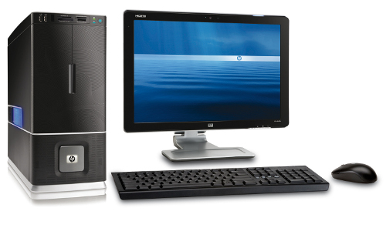
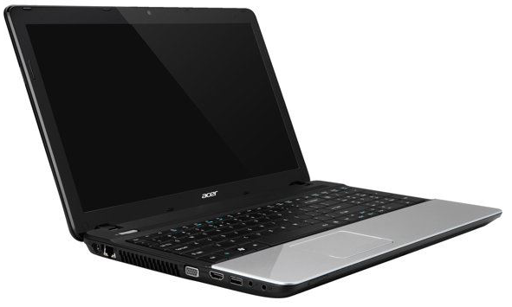
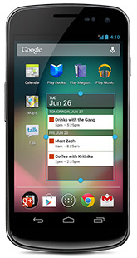
Parallel implementation (1/3)
Parallel hardware and device are everywhere
Parallel programing gets easier
Numerous parallel frameworks are available
Our model seems well adapted to parallel implementation
We choose to use the OpenCL framework to implement it
➔ we can use CPUs, GPUs, FPGAs, etc.

Slide 20
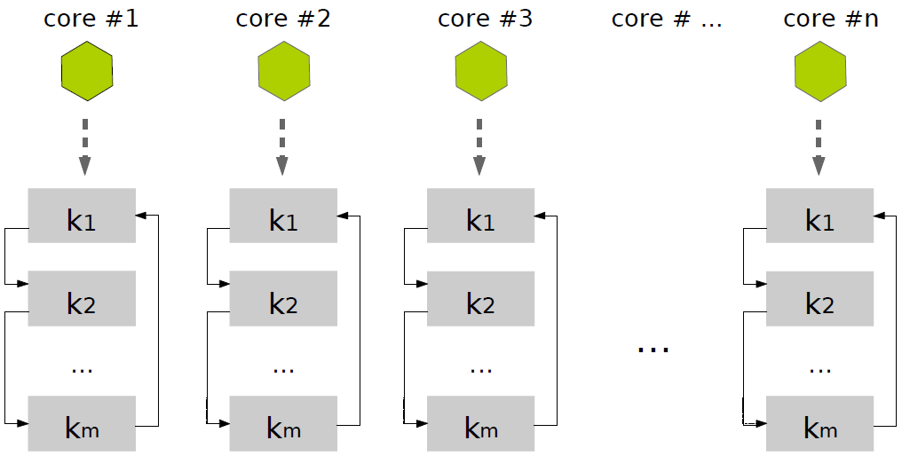
Parallel implementation (2/3)
Fine grained implementation: a cell = an OpenCL core
➔model coupled with a Multi-Agent System
Kernel k1: computes forces
Kernel k2: integrates forces
(Euler method)
Data stored into structures of arrays: nodes, etc.
➔adapted data structure for GPU: a cell = an id
Cells are located in a discrete 2D environment
➔repulsion: one cell (center node) per grid element
No synchronization
required
➔
Virtual chemistry: a chemistry grid element = an OpenCL core
➔ each core, two synchronized tasks: 1) diffusion and 2) reactions

Slide 21
Parallel implementation (3/3)
(cell sorting)
(cell sorting)

Slide 22
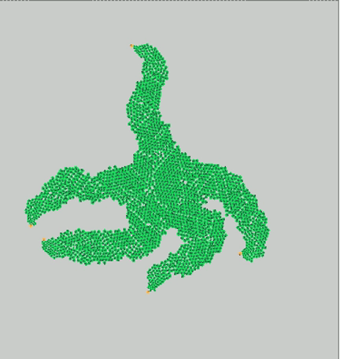
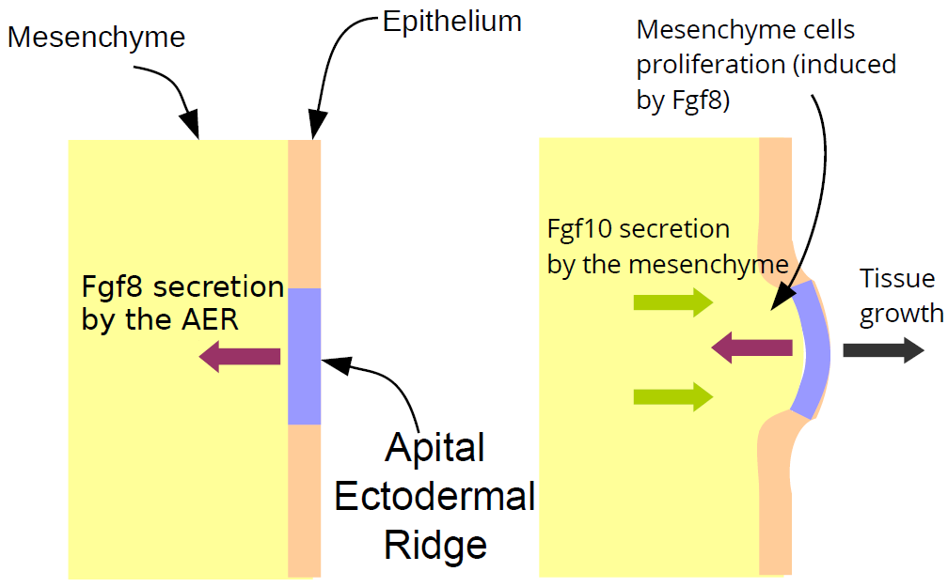
Starfish growth (1/2)
a simplified model
- AER Cells secrete Fgf8 molecules
Fgf8 molecules induce mesenchyme
cells proliferation
Mesenchyme cells response to Fgf8
by secreting Fgf10 molecules
- Fgf10 molecules maintain Fgf8 secretion
starfishgrowth.mp4
Problem: we put the right
cells at the right places….

Slide 23
Starfish growth (2/2)
What is the « program » ?

Slide 24
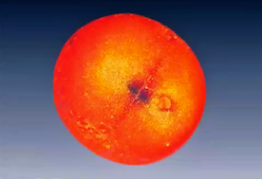
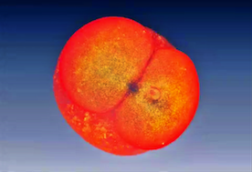
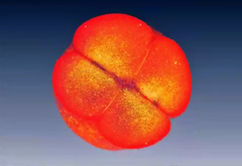
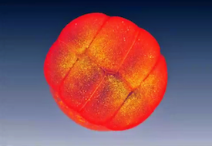
Towards morphogenesis modeling..?(1/2)
Early zebrafish embryo, from [N. Olivier et al, 2010]
During early embryogenesis, we can see (probable) :
Geometric segmentation
Deterministic process
What is the program within cells that controls their placement and their differentiation at the early embryogenesis ?

Slide 25
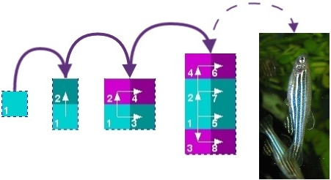
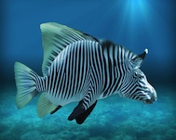
Towards morphogenesis modeling..?(1/2)
Idea:
Find a mathematical model of a well-guided morphogenesis
Generate, from a single cell, all early tissues and the
associate programs
Problem:
Huge number of possibilities !
Our response:
Tissue morphogenesis is a viability problem !

Slide 26
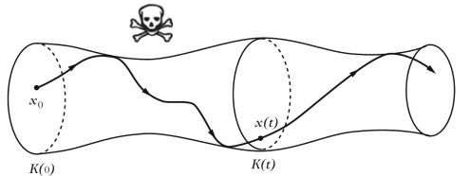
Morphogenesis modeling :
Our approach (1/2)
Our response:
Tissue morphogenesis
is a viability problem !
Graph of viable evolution in a tube,
from [J.P. Aubin, 2001]
Viability Theory (J.P. Aubin, 1991)
Offers concepts and methods to control a dynamic
system to remain in a set of constraints.

Slide 27
Morphogenesis modeling :
Our approach (2/2)
Graph of viable evolution in a tube,
from [J.P. Aubin, 2001]
Viability concepts in morphogenesis
A shape is a state
The directions of division are the controls
The tissues evolve under constraints
A shape can be set as a target

Slide 28
Morphogenesis modeling :
Our model (1/2)
D
x: Mother cell
d=1
⬆
The Environment E: a grid
A cell x : a square which can be placed in the environment
A genetic action d which can be applied by a cell :
d ∈ { ⬆ , ⬇ , ➔ , ⬅ ,  , ∅ } or simply d ∈ { 1 , 2 , 3 , 4 , 5 , 6 }
A genetic action d allow to describe a cell action :
1. Division : x x + d, where d ∈ { 1 , 2 , 3 , 4 } (action)
2. Quiescence : x x + 5 = x (no action)
3. Apoptosis : x x + 6 = 6 (programmed cell death)
M
x x + 1
Create Daughter

Slide 29
Morphogenesis modeling :
Our model (2/2)
A genetic process G : an ordered list of different genetic actions
Example: G = { 1 , 3 , 2 , 4 , 5 , 6 } ... A cell control
AT EACH STEP, a cell will apply this algorithm using G:
for ( action = 0 ; action < G.length ; action = action + 1)
{
if (G[action] can be applied)
{
Apply G[action]
break; /* out of the loop, AT EACH STEP
only one action is applied ! */
}
}
⬆
M
➔
D
Currently, when a mitose occurs,
G is transmitted to the daughter cell…

Slide 30
Morphogenesis modeling :
A case study (1/5)
From a single cell :
What are the all possible tissues to get after
a given number of divisions (phenotypes) ?
For each attained tissue, what is the minimal
underlying genetic process G that governed
cell division and differentiation (genotypes)?
Implementation:
In 2D, discrete in time and space
Evolutions of tissues stored using Boost Graph
Removal of duplicated evolutions :
same shapes by geometric transformation… 87% less !

Slide 31
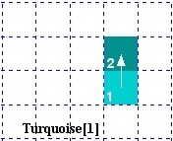
Morphogenesis modeling :
A case study (2/5)
Attainable tissues after 1 division: 1
2 cells
Attainable tissues after 2 divisions: 4
4 cells

Slide 32
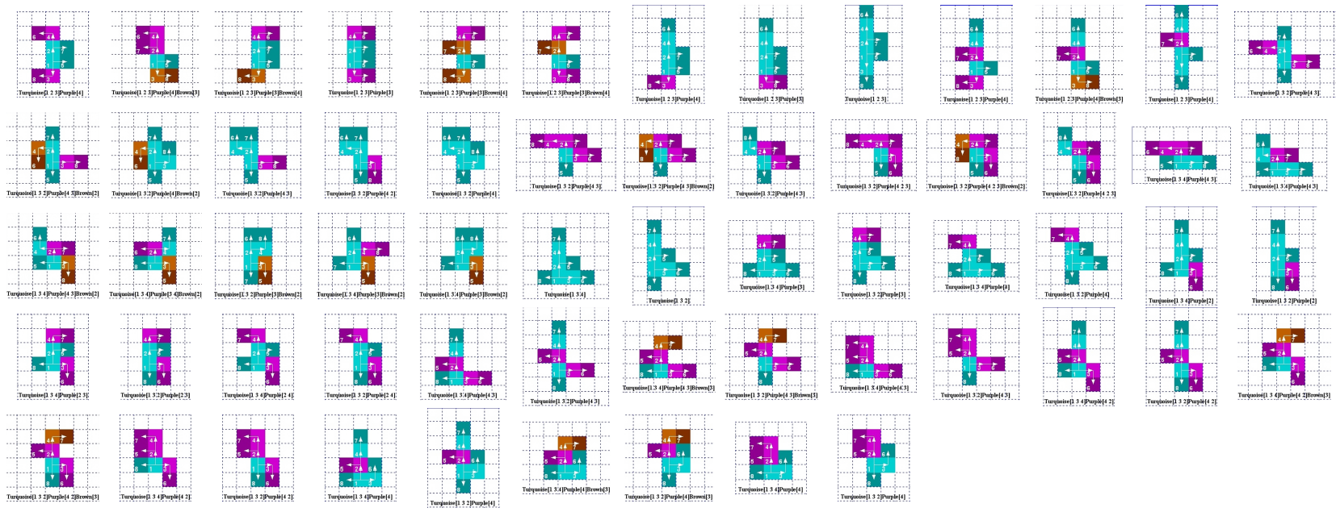
Morphogenesis modeling :
A case study (3/5)
Attainable tissues after 3 divisions: 61
8 cells

Slide 33
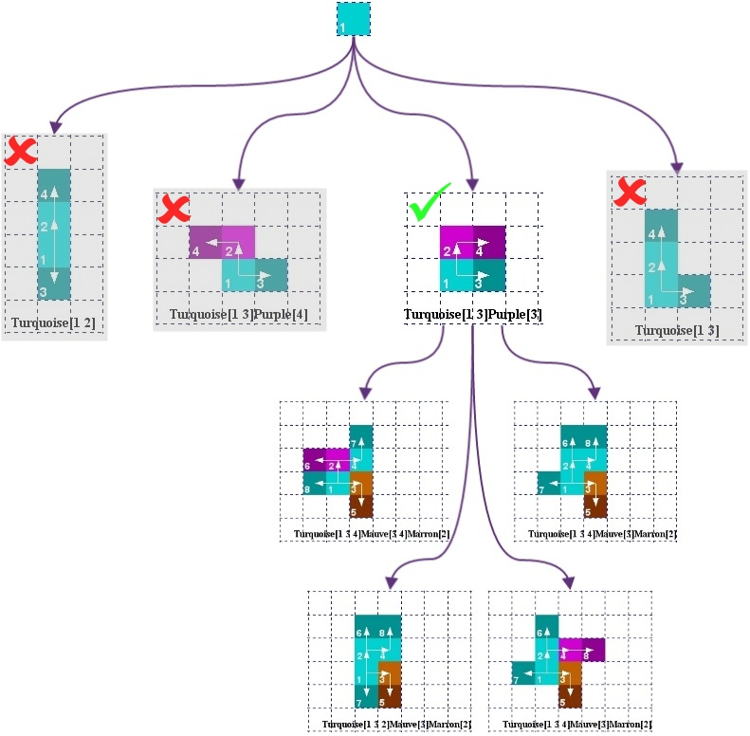
Morphogenesis modeling :
A case study (3/5)
Attainable tissues after
3 divisions
with
selecting after 2 divisions: 4
8 cells

Slide 34
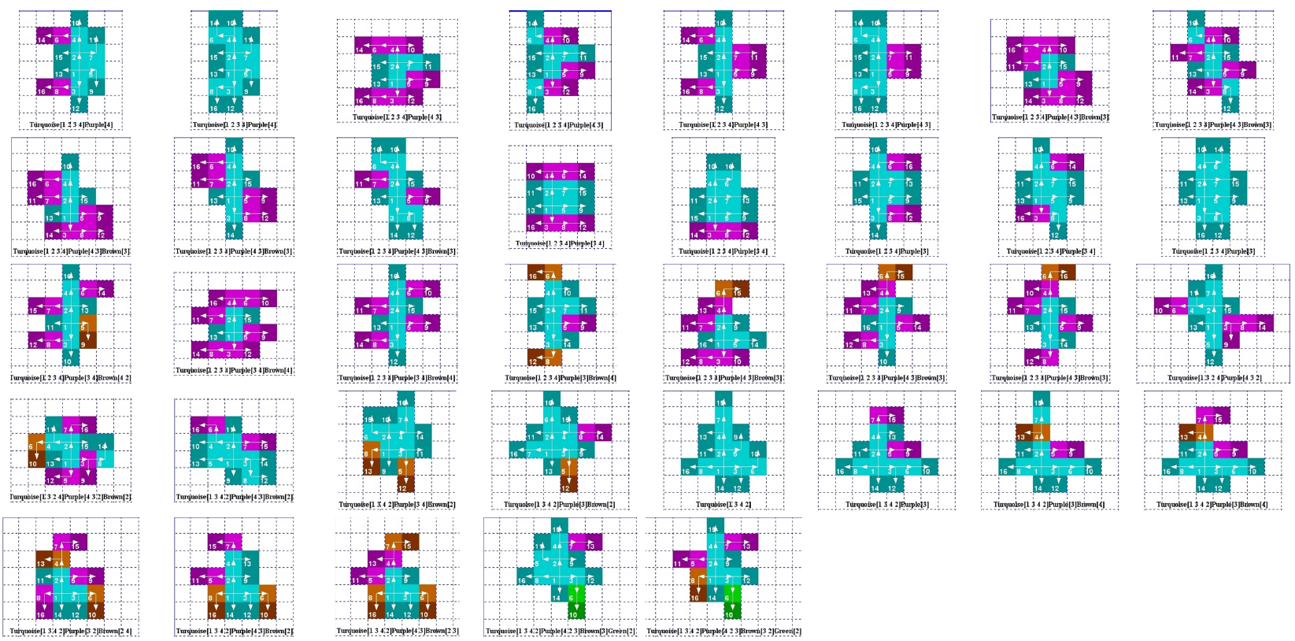
Morphogenesis modeling :
A case study (4/5)
Attainable tissues after 4 divisions: 1029
16 cells

Slide 35
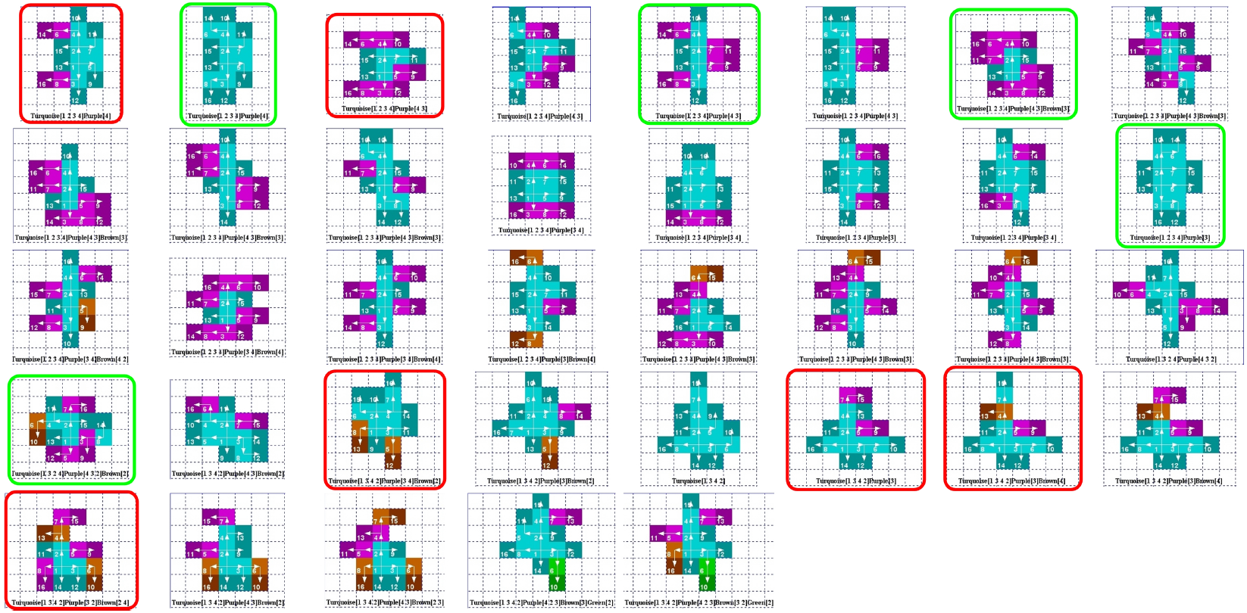
Morphogenesis modeling :
A case study (5/5)
Selection with regard to symmetry, robustness and bio-inspiration of tissues
16 cells

Slide 36
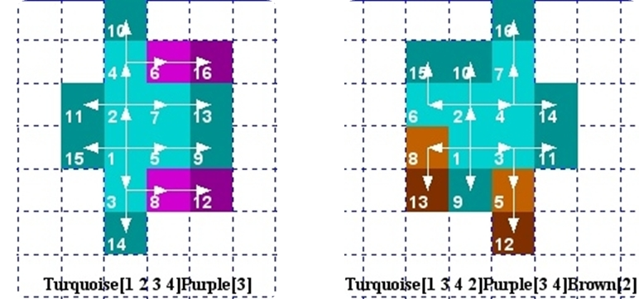
Morphogenesis modeling :
A case study (5/5)
An example that highlights the link between
phenotype and genotype

Slide 37
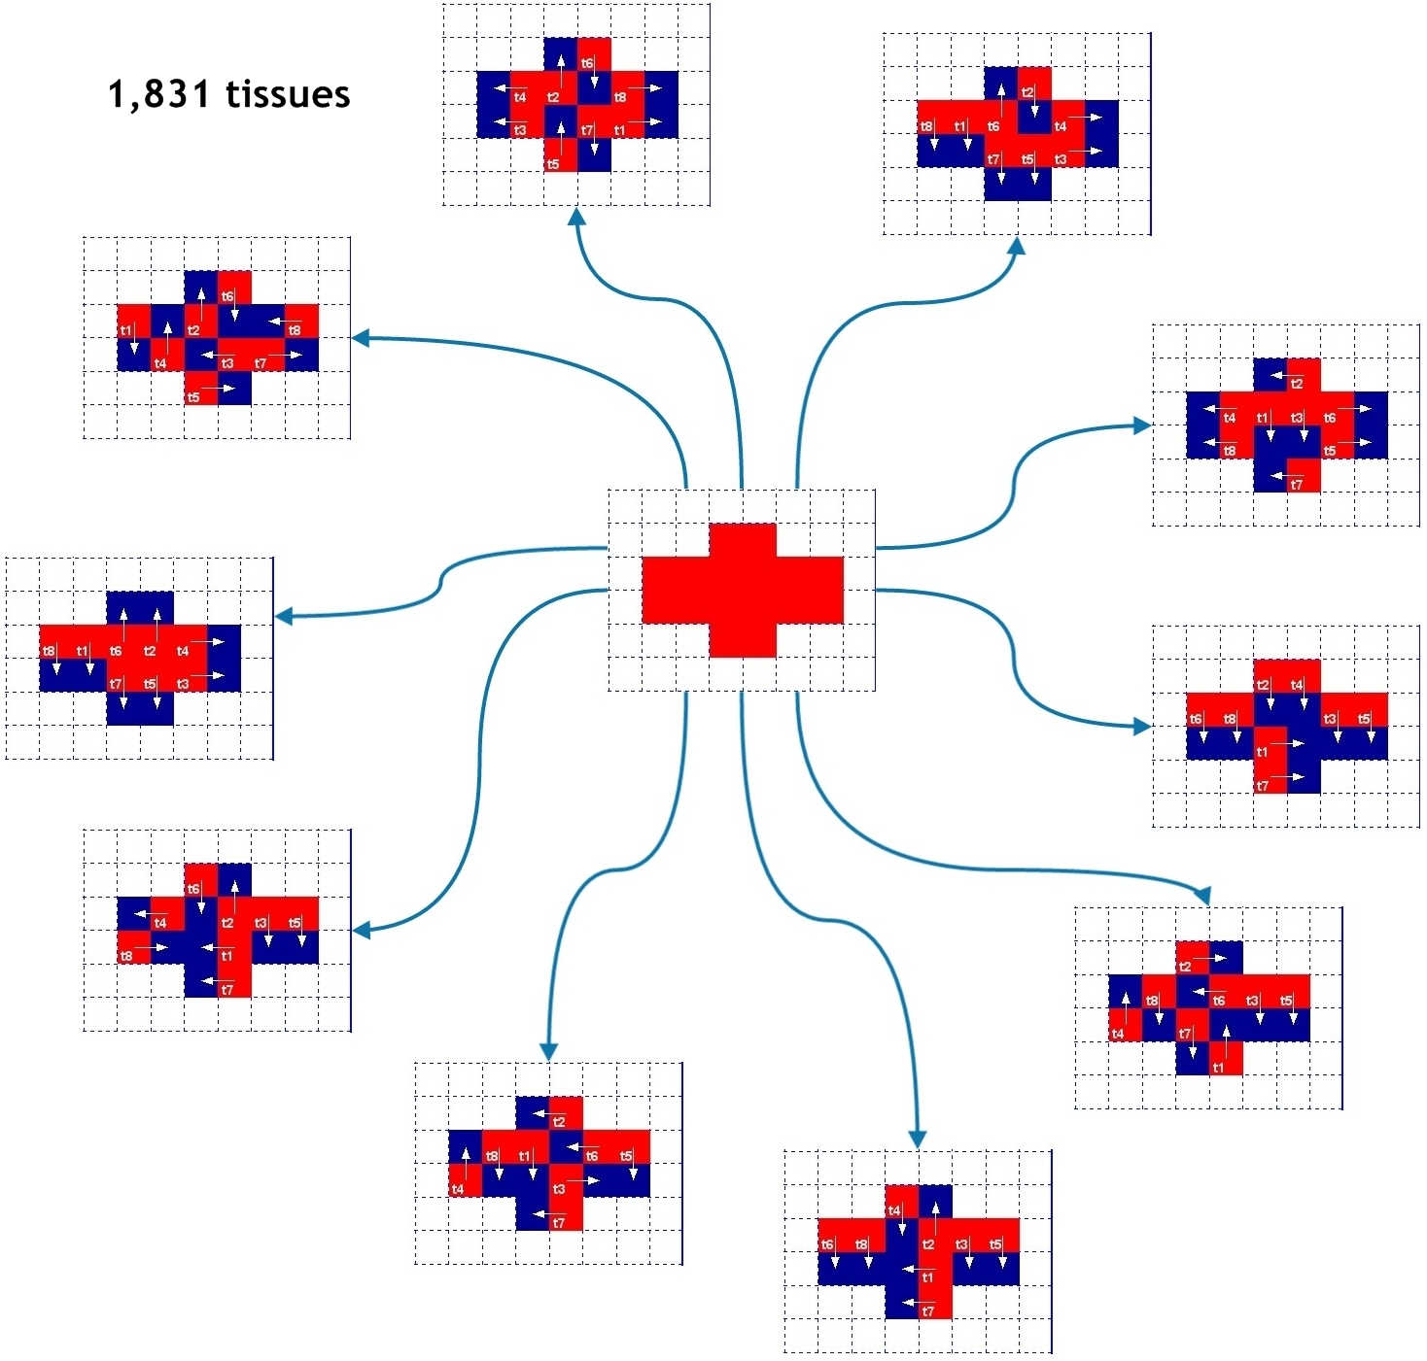
Future works
Merge our virtual cell model and our morphogenesis approach
Use more deeply our morphogenesis model …
And also study backward morphogenesis

Slide 38
Thank you
A. Jeannin-Girardon et Al, IEEE/ACM Transactions on Computational Biology and Bioinformatics (TCBB), 2015
A. Sarr et Al, 3rd international conference on Theory and Practice of Natural Computing (TPNC), 2014

Slide 39
Questions?
Vincent, why did you do that ?
➔ Imagine, we integrate in our cells
just a part of the works
presented in cBio 2015…
➔ We would see, for example, tumor growth taking into account genes, pathways, etc.
➔ We would predict the effect of radiotherapies, chirurgical acts, etc.
A. Jeannin-Girardon et Al, IEEE/ACM Transactions on Computational Biology and Bioinformatics (TCBB), 2015
A. Sarr et Al, 3rd international conference on Theory and Practice of Natural Computing (TPNC), 2014

