Slide 1
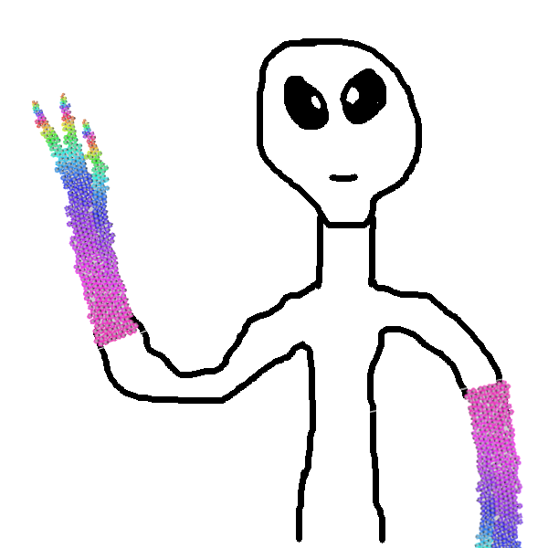
Modélisation multi‐agents et aide à la compréhension de phénomènes physiologiques
Vincent Rodin
vincent.rodin@univ-brest.fr
Lab-STICC, UMR 6285, CNRS,
Département d’Informatique,
Université de Brest

Slide 2
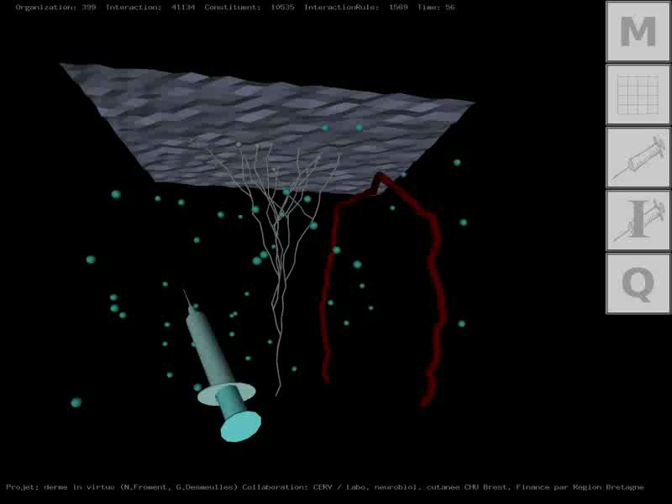
Virtual Reality ➔ Virtual Biology
IHSEV, Lab-STICC
Multi-Agent System approach
Interaction between virtual cells and/or molecules

Slide 3
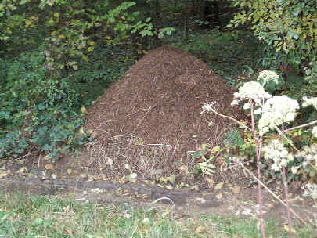
Multi-Agents systems properties
Agent : perception-decision-action
Multi-agents System :
auto-organisation
emergence
robustness
adaptability
Models’ autonomy

Slide 4
Road map
Multi-Agents Systems (MAS)
« in virtuo » experiments
Modelisation and simulation of
human physiological systems
Multiple myeloma simulation
Towards morphogenesis…
… and tumor growth?

Slide 5
« in virtuo » Experiments
Interdisciplinary stories
1997 : CHU de Brest, Immunology
Pr. Pierre Youinou
1998 : CHU de Brest, Hematology
Pr. Jean-François Abgrall
2001 : INSERM Nantes U 463, Cancerology
Pr. François-Régis Bataille
2002 : CHU de Brest, Allergology/Dermatology
Pr. Laurent Misery
…
2009 : IMTh, Lyon
…
2014 : LaTim, Brest
DR. Dimitris Visvikis

Slide 6
« in virtuo » Experiments
Model
Model
Model
in vivo
in vitro
in silico
in virtuo
Model

Slide 7
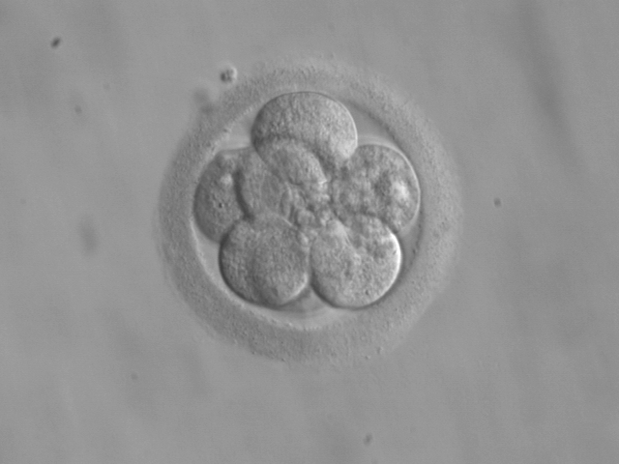
« in virtuo » Experiments
Agent
Multi-agents system
Cell
Multi-cellular system

Slide 8
Road map
Multi-Agents Systems (MAS)
« in virtuo » experiments
Modelisation and simulation of
human physiological systems
Multiple myeloma simulation
Towards morphogenesis…
… and tumor growth?

Slide 9
Modelisation and simulation of
human physiological systems
Interface-Agent
Reaction-agent
Cell-agent

Slide 10
Cell-agent model
Basic behaviours
Mitosis
Activation
Behaviours
Internalisation
Expression of receptor
Apoptose
Model of located agents with
complex behaviors

Slide 11
Cell-agent model:
An example of application
Simulation of physiologic coagulation:
Cell
Fibroblasts cells, endothelial cells, platelets
Procoagulant factors
TF, I, II, V, VII, VIII, IX, X, XI, …
Inhibitor factors
PC, TFPI, AT3, α2M, PS, PZ, …
P
…
I
II
PC
…
…
VII
Flux
IXa
Xa
Coagulation Cascade
VIIa
VIIa
F.W
F.W
F.W
F.W
Endothelial cell
Fibroblasts + Tissue Factors

Slide 12
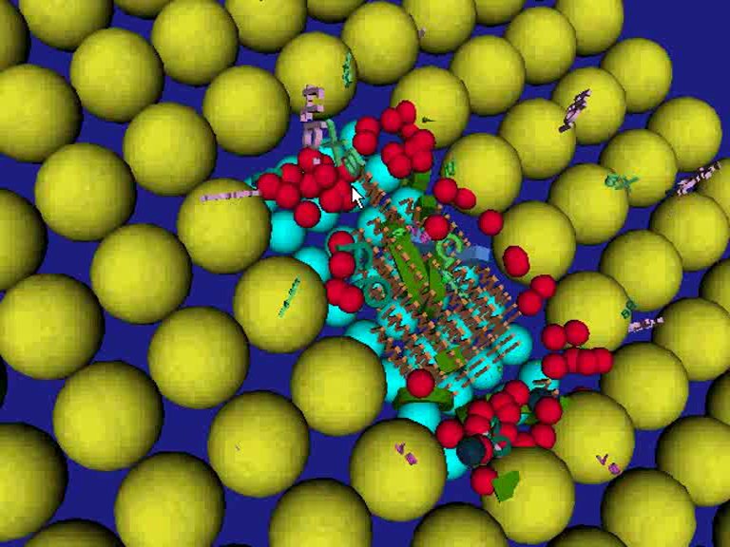
Cell-agent model:
An example of application

Slide 13
Cell-agent model:
An example of application
Elements of validation of the coagulation
multiagents model :
Comparison with Biological experiment
Curve of thrombin
Generation
[Hemker, 1995]
Coherence with respect to pathologies

Slide 14
Cell-agent model:
An example of application
Simulation of physiologic coagulation:
Healthy patient, hemophiliac,
hemophiliac with treatment
Thrombin
generation
Thrombin
generation
Normal
coagulation
Normal
coagulation
Hemophilia A
Hemophilia B
+ NovoSeven
Hemophilia B
Hemophilia B
Time
Time
in seconds
in seconds

Slide 15
Modelisation and simulation of
human physiological systems
Interface-Agent
Reaction-agent
Cell-agent
Located agent

Slide 16
Reaction-agent model
« microscopic » level:
« macroscopic » level:
agent = cell/molecule
agent = reaction
1: reading of the concentrations
in reactants
2: calculation the reaction speed and then the quantity of reactant to be reacted
perception
decision
reaction
action
3: consequently, modification of the
concentrations in reactants and products

Slide 17
Reaction-agent model
Spatial
indiscernibility
…
r₁
r₂
Non located agents
r_{m}
C₁, C₂, …, C_{n}
Chemical reactor

Slide 18
Reaction-agent model
d[S₁]/dt = – kcat₁[E₁][S₁]/(Km₁+[S₁])
– kcat₃[E₁][S₁]/(Km₃+[S₁])
d[S₂]/dt = + kcat₂[E₂][S₂]/(Km₂+[S₂])
d[P₁]/dt = – kcat₁[E₁][S₁]/(Km₁+[S₁])
– kon₃[P₁][P₂]
+ kcat₃[E₁][S₁]/(Km₃+[S₁])
d[P₂]/dt = + kcat₂[E₂][S₂]/(Km₂+[S₂])
– kon₃[P₁][P₂]
d[P₁P₂Complex]/dt = kon₃[P₁][P₂]
E₁ + S₁ → E₁ + P₁
E₂ + S₂ → E₂ + P₂
P₁ + P₂ → P₁P₂Complex
E₃ + S₁ → E₃ + P₁
new EnzimaticReaction(plasma, E₁, S₁, P₁, kcat₁, Km₁);
new EnzimaticReaction(plasma, E₂, S₂, P₂, kcat₂, Km₂);
new ComplexFormationReaction(plasma, P₁, P₂, P₁ P₂Complex, kon₃);
new EnzimaticReaction(plasma, E₃, S₁, P₁, kcat₃, Km₃);

Slide 19
Reaction-agent model:
An example of application
Fibroblaste + VIIa -> VII-TF
VII + VIIa -> VIIa + VIIa
VII + VII-TF -> VIIa + VII-TF
IX + VII-TF -> IXa + VII-TF
X + VII-TF -> Xa + VII-TF
TFPI + Xa -> TFPI-Xa
TFPI-Xa + VII-TF -> 0
VII + IXa -> VIIa + IXa
IXa + X -> IXa + Xa
II + Xa -> IIa + Xa
XIa + IX -> XIa + IXa
XIa + XI -> XIa + XIa
IIa + XIa -> IIa + XIa
IIa + VIII -> IIa + VIIIa
IIa + V -> IIa + Va
Xa + V -> Xa + Va
Xa + VIII -> Xa + VIIIa
Xa + Va -> Va-Xa
VIIIa + IXa -> VIIIa-IXa
VIIIa-IXa + X -> VIIIa-IXa + Xa
Va-Xa + II -> Va-Xa + IIa
AT3 + (IXa, Xa, XIa, IIa) -> 0
alpha2M + IIa -> 0
I + IIa -> Ia + IIa
TM (endo cell) + IIa -> IIi
AT3(endo cell) + (IXa, Xa, XIa, IIa) -> 0
ProC + IIi -> PCa + IIi
PCa + Va -> 0
PCa + Va-Xa -> Xa
PCa + PS -> PCa-S
PCa + PCI -> 0
PCaS + Va -> 0
PCaS + V -> PCa-S-V
PCa-S-V + VIIIa-IXa -> IXa
PCa-S-V + VIIIa -> 0
Simulation of physiologic coagulation:
Healthy patient, hemophiliac,
hemophiliac with treatment
Thrombine
generation
Thrombine
generation
Normal
coagulation
Normal
coagulation
Hemophilia A
Hemophilia B
+ NovoSeven
Hemophilia B
Hemophilia B
Time in
Time in
½ seconds
½ seconds
42 reactions

Slide 20
Modelisation and simulation of
human physiological systems
Interface-Agent
Reaction-agent
Non located agent
Cell-agent
Located agent

Slide 21
Interface-agent model:
Transport
phenomena
Interface
advection
diffusion
Chemical
reactor
Chemical
reactor
Interface
Medium
Medium
Chemical
reactor
Medium
Interface-agent
Interaction between mediums

Slide 22
Modelisation and simulation of
human physiological systems
Systemic approach
Interface-Agent
Transport agent
Reaction-agent
Non located agent
Cell-agent
Located agent

Slide 23
Modelisation and simulation of
human physiological systems

Slide 24
Modelisation and simulation of
Multiple Myeloma
Vincent, you didn’t talk
about cancer today !!
Cell-agent model
Behaviours
Internal machinery

Slide 25
Road map
Multi-Agents Systems (MAS)
« in virtuo » experiments
Modelisation and simulation of
human physiological systems
Multiple myeloma simulation
Towards morphogenesis…
… and tumor growth?

Slide 26
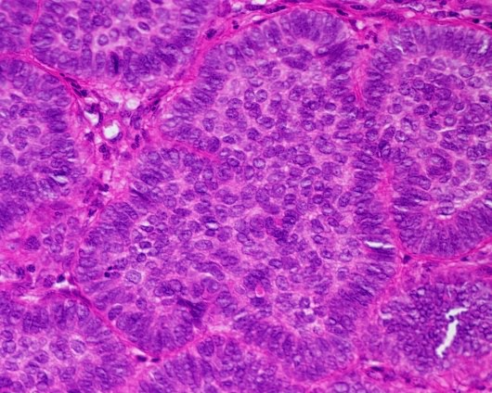
Modelisation and simulation of
Multiple Myeloma
Collaboration
INSERM Nantes U 463,
Pr. F.R. Bataille
IL-6
CD45++
CD45+
Good prognosis
MC
Bad prognosis
MC
CD45-
CD45++
IL-6 + IGF-1

Slide 27
Modelisation and simulation of
Multiple Myeloma
Collaboration
INSERM Nantes U 463,
Pr. F.R. Bataille
CD45
IL-6
IGF1
TNF
IRS1
Lyn
RAS
IKK
PI3K
RAF
NFKB
AKT
MEK
ERK
CD45 synthesis
Proliferation
Proliferation

Slide 28
Modelisation and simulation of
Multiple Myeloma
Collaboration INSERM Nantes U 463, Pr. F.R. Bataille
3D Visualisation
Myeloma cells CD45+
Myeloma cells CD45++
Bone matrix
2D Visualisation
MEDIUM1
MEDIUM2

Slide 29
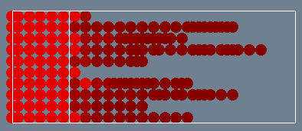
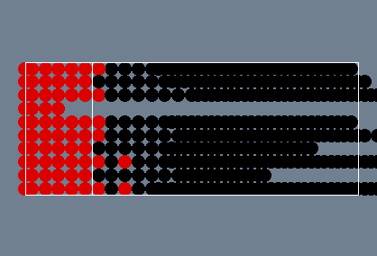
Modelisation and simulation of
Multiple Myeloma
Collaboration
INSERM Nantes U 463,
Pr. F.R. Bataille
CD45
IL-6
IGF1
TNF
IRS1
Lyn
RAS
IKK
Hypothesis testing:
RAS mutation
PI3K
RAF
NFKB
Without RAS mutation
AKT
MEK
ERK
CD45 synthesis
Proliferation
Proliferation
With RAS mutation

Slide 30
Road map
Multi-Agents Systems (MAS)
« in virtuo » experiments
Modelisation and simulation of
human physiological systems
Multiple myeloma simulation
Towards morphogenesis…
… and tumor growth?

Slide 31
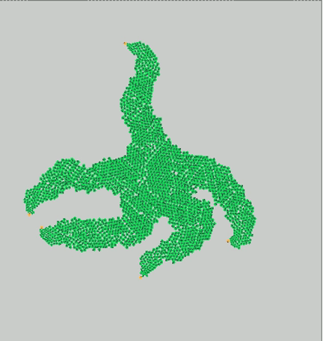
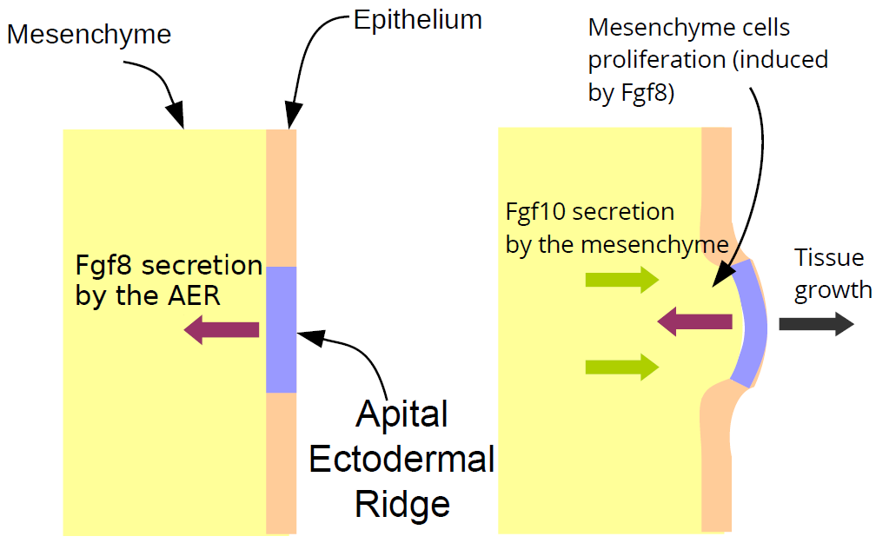
Starfish growth (1/2)
Towards morphogenesis:
a simplified model
- AER Cells secrete Fgf8 molecules
Fgf8 molecules induce mesenchyme
cells proliferation
Mesenchyme cells response to Fgf8
by secreting Fgf10 molecules
- Fgf10 molecules maintain Fgf8 secretion
Problem: we put the right
cells at the right places….

Slide 32
Starfish growth (2/2)
Towards morphogenesis:
What is the « program » ?

Slide 33
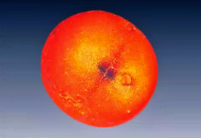
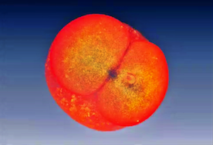
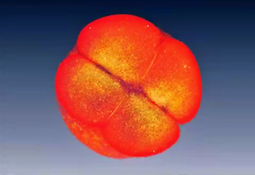
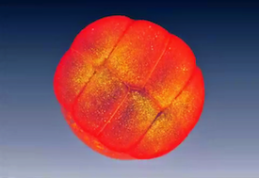
Towards morphogenesis modeling..?(1/2)
Early zebrafish embryo, from [N. Olivier et al, 2010]
During early embryogenesis, we can see (probable) :
Geometric segmentation
Deterministic process
What is the program within cells that controls their placement and their differentiation at the early embryogenesis ?

Slide 34
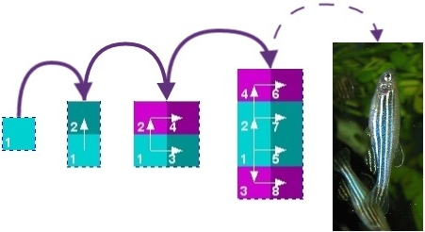
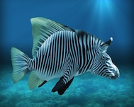
Towards morphogenesis modeling..?(1/2)
Idea:
Find a mathematical model of a well-guided morphogenesis
Generate, from a single cell, all early tissues and the
associate programs
Problem:
Huge number of possibilities ! ➔ viability theory (J.P. Aubin)
And now:
Cancer growth modeling ! ➔ collaboration LaTIM (Dimitris)

Slide 35
Thank you
Abdoulaye, Alexandra, Anne, Dimitris, François,
François, François-Régis, Gabriel, Gireg, Jacques,
Jean-François, Jérémy, Karine, Laurent, Laurent,
Mikaël, Michaël, Nicolas, Pascal, Pascal, Sébastien, Sébastien, Séna

